Slide 1





EEET2490 - Embedded system: os and interfacing
gROUP aSSigment

Slide 2



Team member
Kim Nhat Anh
s3978831
Huynh Ngoc Tai
s3978680
Tran Quang Minh
s3988776
Vu Thien Minh Hao
s3938011
Odd
Even

Slide 3


Project overview
Build a bare-metal OS for Raspberry Pi
Implement CLI, screen rendering, and an interactive game
Main Tasks:
CLI with commands, history, and auto-completion
Custom font & display (image/video/text)
Simple game with UART control and logging

Slide 4


Task 1: CLI implementation
ASCII welcome message
Command prompt (FixingGoodOS>) Supported commands: help, clear, showinfo, baudrate, handshake Command history (-, = keys)
Auto-complete with Tab
Live feedback via UART

Slide 5
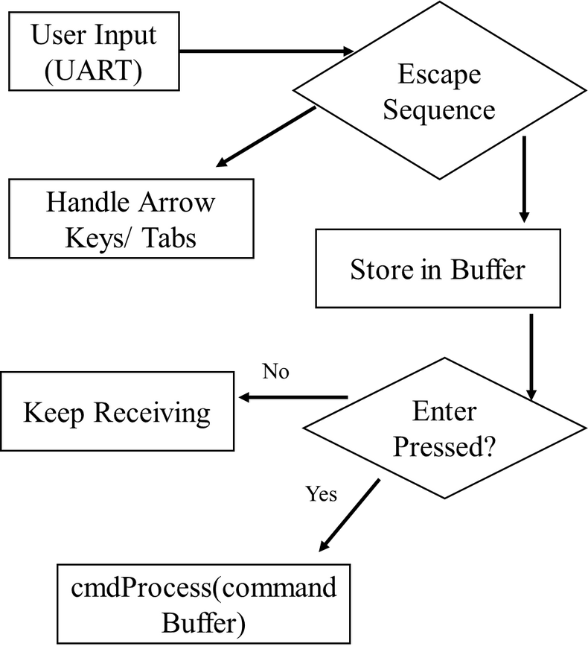
Task 1: CLI implementation
Full input buffer
Idle
Split by space → cmd + arg
Command Parsing Logic
History Index--
ArrowUp
Loop: Compare cmd with commands
History Index++
ArrowDown
commands[i].cmdFunc(arg)
Match
Command History
Display previous command
CLI Input Flowchart
Print response or update system

Slide 6
Task 1: CLI implementation
Feature Group | Command/ Feature | Implementation | Testing (any issues/limitations)
CLI Basic Features | welcome screen | complete | Displays on UART boot
 | help | complete | Shows usage with and without args
 | clear | complete | Clears screen using ANSI codes
 | showinfo | complete | Displays MAC and board revision
 | baudrate | complete | Changes UART0 baudrate live

Slide 7
Task 1: CLI implementation
CLI Enhancement | OS name in CLI | complete | Static prompt FixingGoodOS>
 | Auto-completion in CLI | complete | Matches prefix and fills input
 | Command history in CLI | complete | Works with “–“ (going back) and “=” (going forward) (We don’t use “-” and ”+” because it would require an extra shift on keyboard)

Slide 8

Task 2: Font and video display implementation
Background image with team member names
Names rendered using custom 8x15 font
Font System: Derived from Tamzen8x15.bdf
Parsed and converted into bitmap .h file
Drawn using drawPixelARGB32()
Short video rendered frame-by-frame (80 frames, ~10 FPS)

Slide 9
Task 2: Font and video display implementation
Font Rendering Flow
Image Rendering Logic
Video Rendering Logic
char
drawImg()
videoDisplay()
font[ch] (8x15 bitmap)
pixel_data[]
video_allArray[]
for each bit
drawPixelARGB32(x, y, pixel_data[i])
drawImg video_allArray[i]
drawPixelARGB32(x, y, color)
Repeat until finish
wait_msec(100)

Slide 10
Task 2: Font and video display implementation
Image, Video, and Text Display | Background image and text display | teamdisplay | Shows names of 4 members in color with the RMIT background.
 | Video display | videodisplay | 80 frames, ~10 FPS

Slide 11
Task 3: Game Implementation - Basketball hoop
Gameplay:
Move hoop left/right via UART (keys a, d)
Catch balls = +score, avoid bombs = -score
Bombs reduce the score
Game stages: 3 levels with time and score goals
Technical Details:
Collision detection using AABB
Framebuffer-based sprite rendering
Logs sent back to CLI via UART

Slide 12
Task 3: Game Implementation - Basketball hoop
Main Game Loop Flow
GameObject Interaction Diagram
Start Game
player ↔ ball[n]
drawBackground
Game Loop
tags: NORMAL, SPECIAL, BOMB, ENLARGE, MULTIPLY
Move Player ← / → (UART)
Spawn / Update Balls
NORMAL → score += 10
BOMB → score -= 100
ENLARGE → player.w += offset
SPECIAL -> score += 30
MULTIPLY -> x2 score received
Collision Detection
Score Update / Effects
Check Score for Stage / Win

Slide 13
Task 3: Game Implementation - Basketball hoop
In-Game Menu (FSM)
UART Input Handling in Game
Running Game
char key = uart_getc()
ESC pressed
key == 'a' → player.x -= speed key == 'd' → player.x += speed key == 'p' → pause
Pause Menu
→ Continue
→ Restart
→ Exit

Slide 14


Overall Conclusion
A
B
Low-level hardware interfacing
Custom CLI and rendering pipeline
C
D
Improved embedded C design
Handling real-time inputs and visual feedback through UART

Slide 15
DEMO
TIME

